Slide 1
Safe New Jersey Campaign
Presented by,

Slide 2
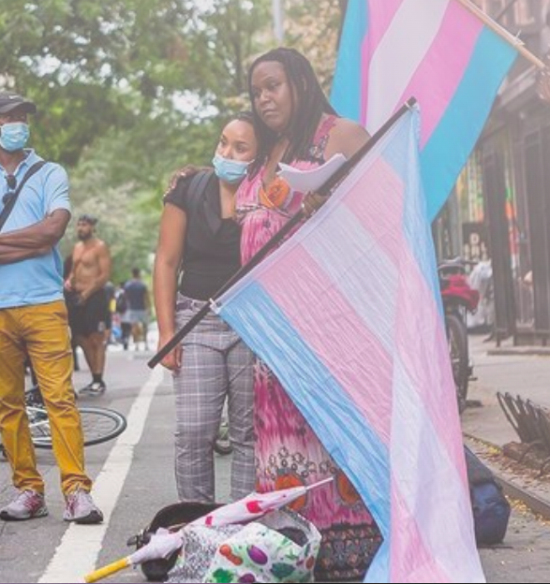
CEO: Tahtianna Fermin
Tahtianna Fermin is the founder and CEO of Bridges4Life, which works to help teens and young adults on street and in foster care become responsible, self-sufficient, confident and educated adults. Bridges4Life provides housing, preparation for adulthood, prevention services, and assists young people in negotiating aging-out services within the foster care system. Bridges4Life’s works within existing programs and resources to leverage new opportunities for the teens and young adults involved in the program, empowering social change agencies to develop local strategies for urban service.

Slide 3
The goal of this presentation is not to recruit rather inform!

Slide 4
SEX WORK IS WORK

Slide 5
The earliest mention of sex work makes the profession 4400 years old which puts it close to priests as one of the oldest professions of all time.
Evidence for prostitution as an occupation dates to 2400 BCE in Mesopotamia.
Sex work is the oldest profession in the world.

Slide 6
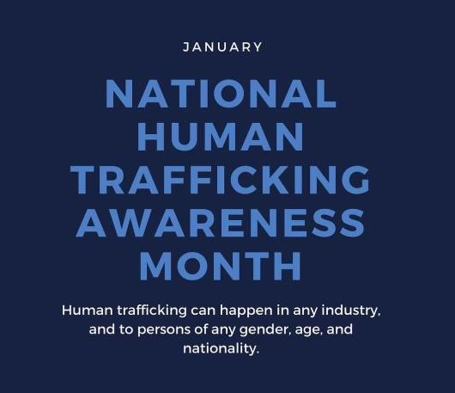
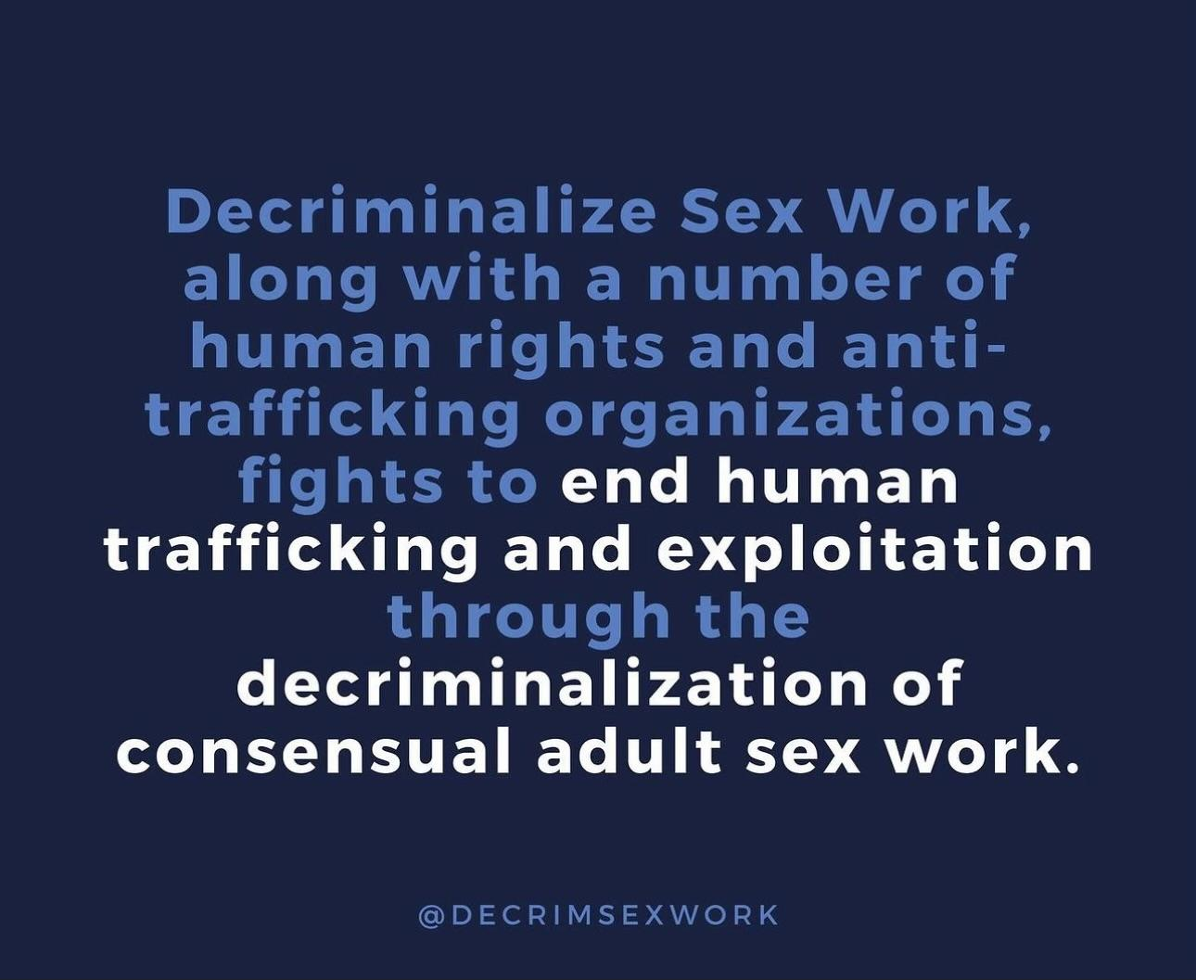
designed to educate the public about human trafficking and the role they can play in preventing and responding to human trafficking.
January 1st - Human Trafficking Awareness

Slide 7
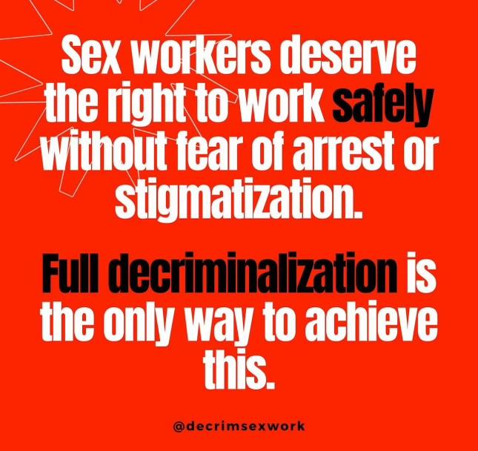
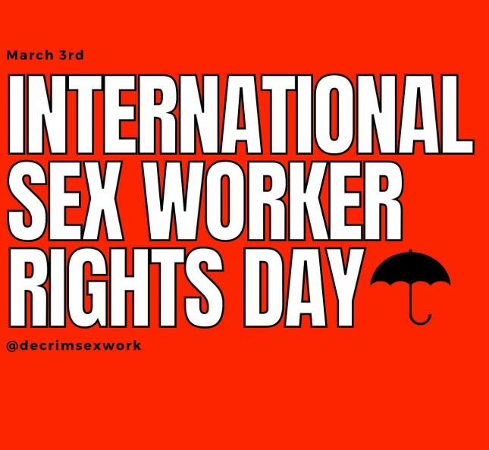
Sex workers and activists organize protests, gatherings, art shows, and lectures across the globe to raise awareness about the human rights abuses sex workers face.
March 3rd - International Sex Worker Rights Day

Slide 8
International Whores' Day or International Sex Workers' Day honours sex workers and recognises their often exploited working conditions.
June 2nd International
Whores’ Day/Sex Workers’ Day

Slide 9
December 17
Observed annually on December 17 by sex workers, their advocates, friends, families, and allies.
Violent crimes against sex workers go underreported, underaddressed and unpunished.
International Day to End Violence Against Sex Workers
The red umbrella is a symbol for sex workers rights, first used in Venice Italy in 2001. The symbol protests inhumane work conditions and human rights abuses.
The day calls attention to hate crimes committed against sex workers worldwide as well as the need to remove social stigma and discrimination that have contributed to violence against sex workers and indifference from the communities they are part of.

Slide 10
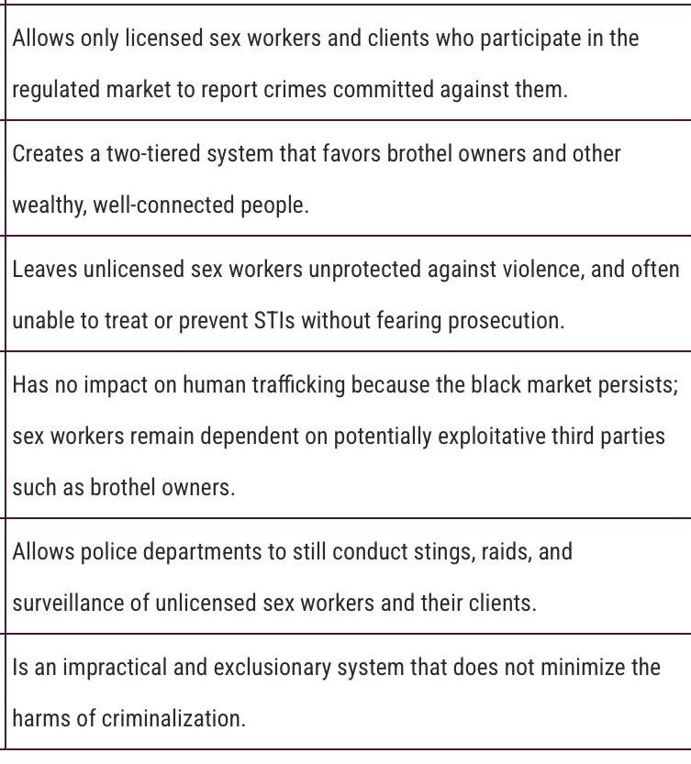
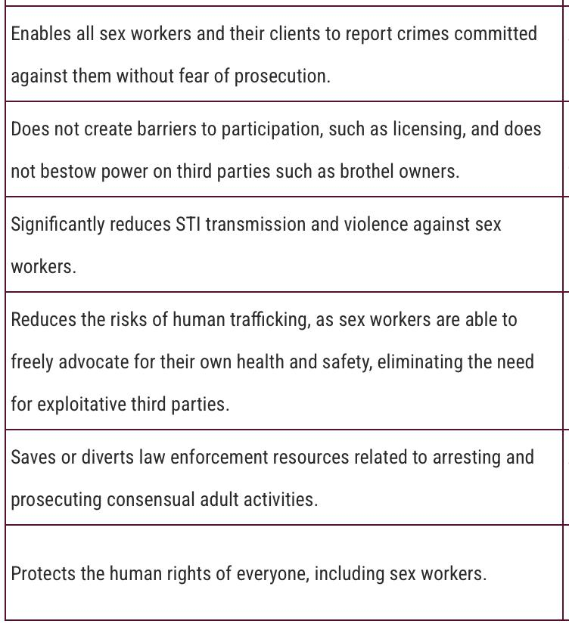
Legalize Vs. Decriminalize

Slide 11
Current Status of Legalized Prostitution
A number of European countries have legalized prostitution in which selling sex is allowed (under certain circumstances), but paying for it is not.
Must register within the state
Have a professional certificate
Work in a licensed brothel
Belgium is the first country in Europe to officially decriminalize selling sex, paying for it, and working with sex workers.
New Zealand decriminalized prostitution in 2003.

Slide 12
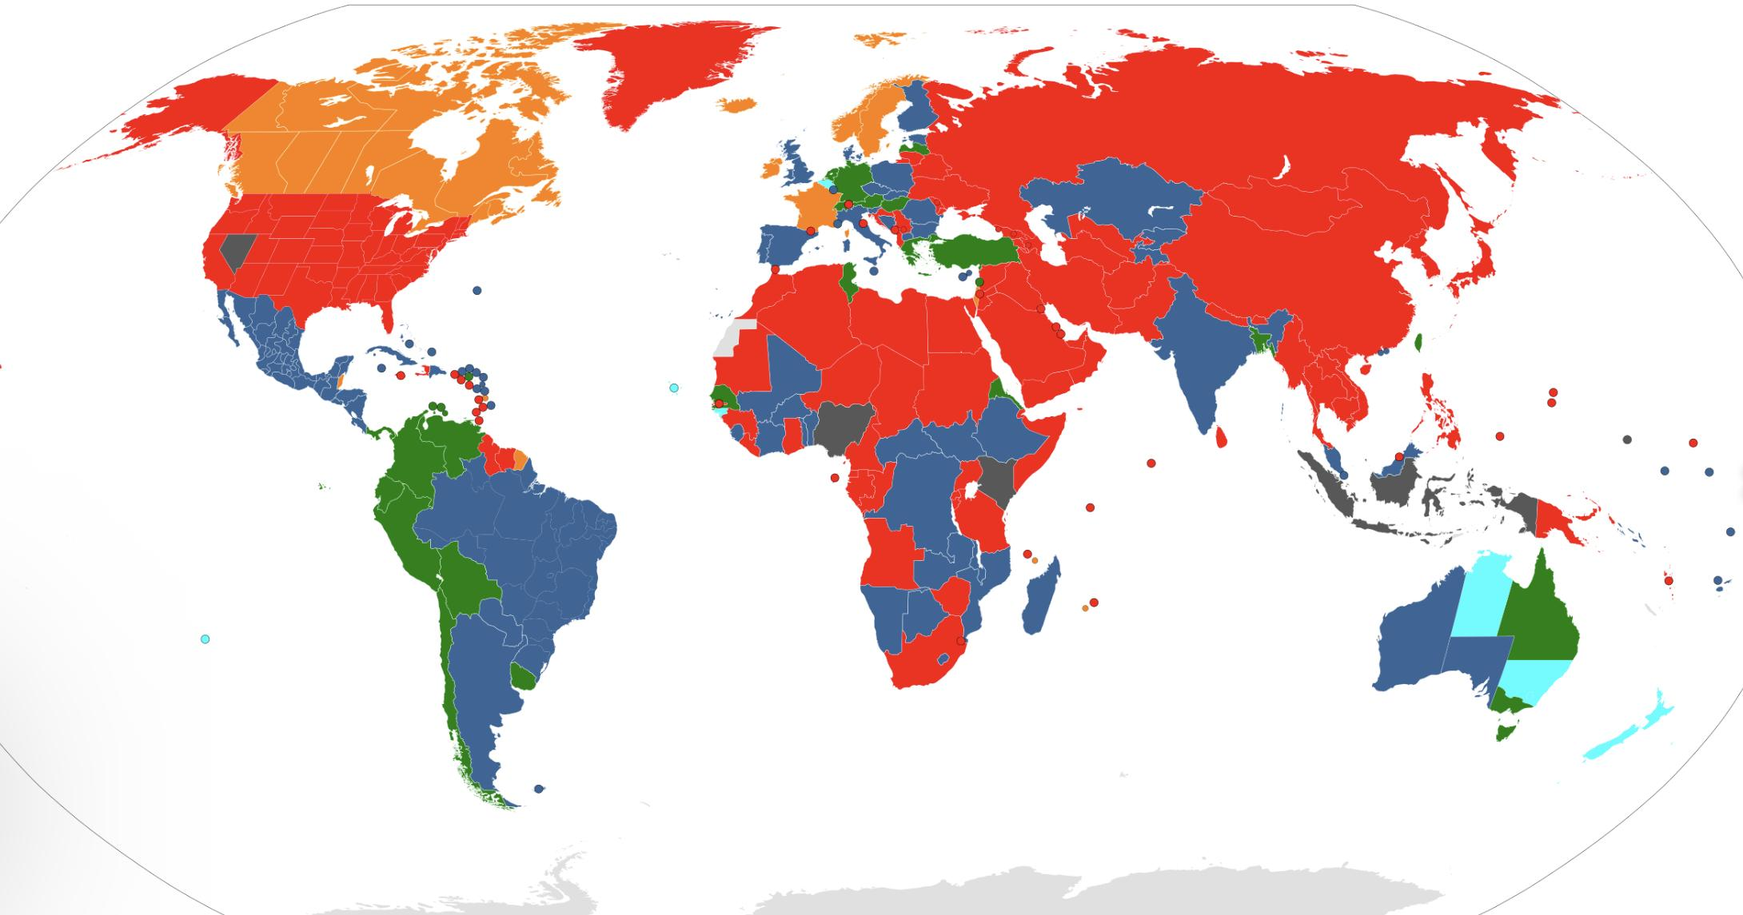
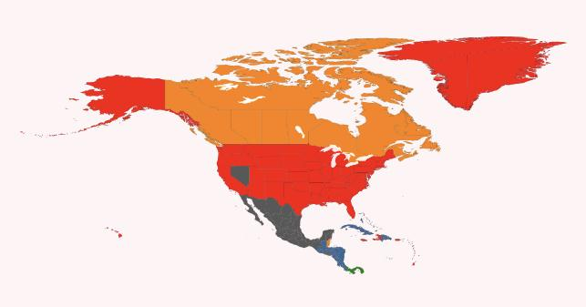
Maine is the only US state to have Neo-Abolitionism or the “Nordic Model”,
while Nevada has some Legalization
Legality of Prostitution Worldwide
Legality of Prostitution in North America

Slide 13
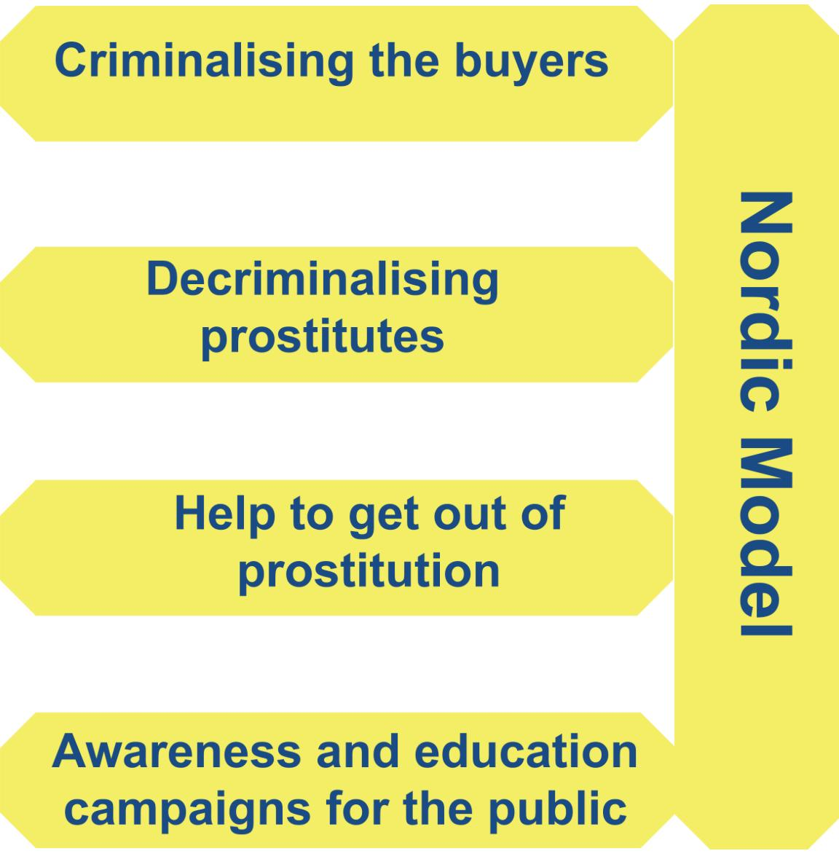
What is the “Nordic Model” or “Neo-abolitionism”?
Fight Online Sex Trafficking Act (FOSTA)
Stop Enabling Sex Traffickers Act (SESTA)
Harmful policies which governs sex work that criminalizes sex workers’ clients for purchasing services, forcing them to work in secret.
subordinates women
promotes inequality between the sexes
ignores that sex workers face violence from law enforcement and not just clients, managers, or pimps.

Slide 14
Rhode Island and Legal Indoor Sex Work
In 2003, Rhode Island realized that it had accidentally legalized indoor sex work (through a legal loophole), after attorney Mike Kiselica successfully argued for his sex worker clients that as long as actions were between two consenting adults, it didn’t matter what they agreed to, as long as they did in private, and it could certainly involve anything including money.
Rhode Island re-criminalized all prostitution in 2009, but reported rapes went down by 31% and reported statewide gonorrhea diminished by 39% when prostitution was legal indoors.

Slide 15
Pushing sex work underground makes it dangerous.
Workers are forced to work in secrecy which can
harm their safety and livelihood.
The criminalization of consensual adult sex work is a
violation of human rights.

Slide 16
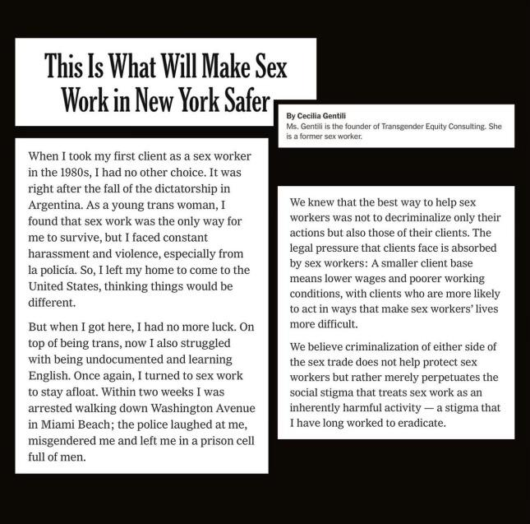

Slide 17
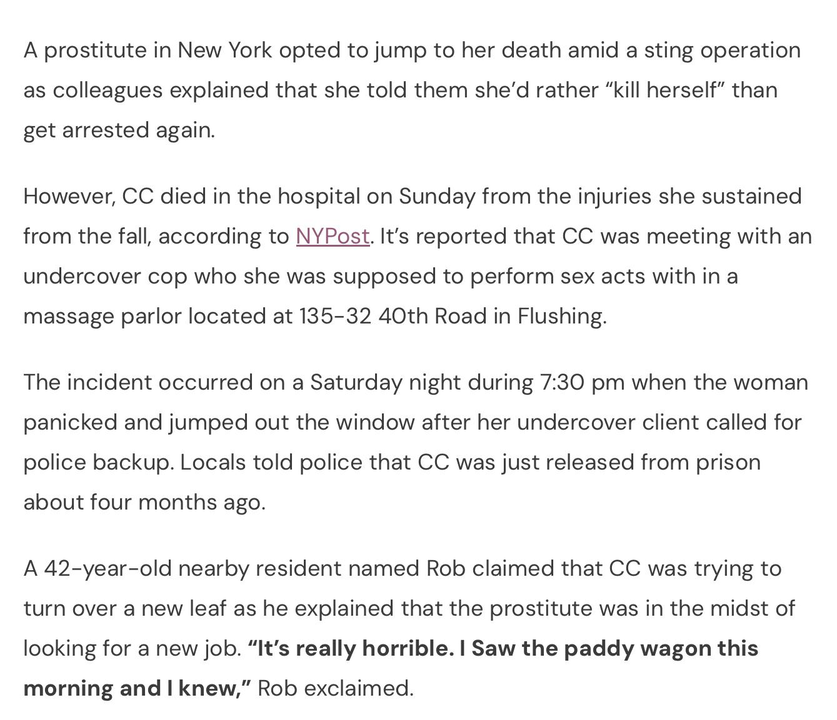
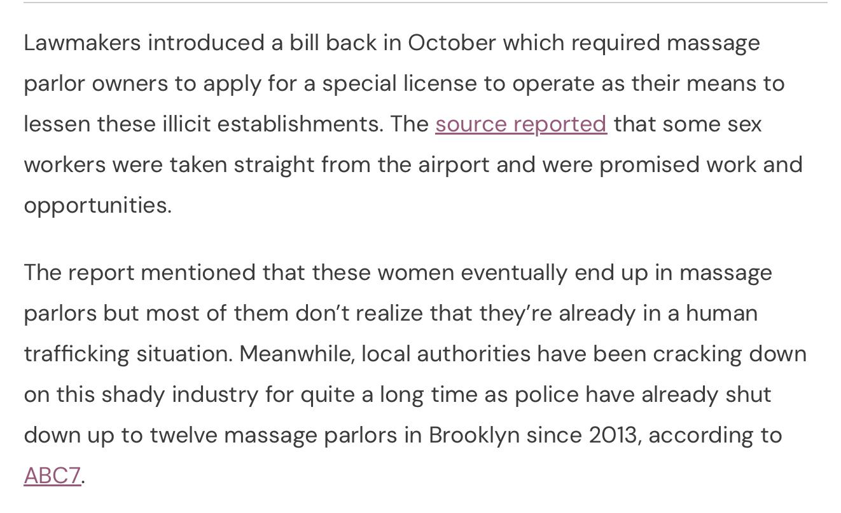
This is the story of SiSi, who was the owner of the massage parlor in New York City in Flushing, Queens, who supposedly jumped to her death, through a sting operation, but family members feel that she was purposely murdered by NYPD.
The Story of SiSi (Yang Song)

Slide 18
Solution: Decriminalize Sex Work
We encourage you to call on Congress to repeal laws like SESTA/FOSTA which have pushed sex workers and trafficking victims into more dangerous and exploitative situations.

Slide 19
Bridges4Life aims to make progress towards equity and bodily autonomy.
No one should be criminalized for
making choice about their own body.
DECRIMINALIZE SEX WORK
DECRIMINALIZE ABORTION
DECRIMINALIZE CHOICE
MAXIMIZE CONSENT

Slide 20
Ways to be an Ally
Don’t assume or judge
Respect personal boundaries
Address your prejudices
Respect that sex work is real work
Don’t play rescuer
Realize sex work transcends
race, gender, class, etc.
Don’t let stigma and bigotry continue

Slide 21
Thoughts?
Feedback?

Slide 22
CONTACT
THANKS!
SEX
WORKERS
MATTER
contact@bridges4life.org
(201)-343-1349
bridges4life.com

