Slide 1
Do Influencers Help Or Hurt The Sex Work Industry?
A Look at the Works of Dan Savage
Presented By
Ana Blue
Ana Blue
QueenAnaBlue.com
July 2024

Slide 2
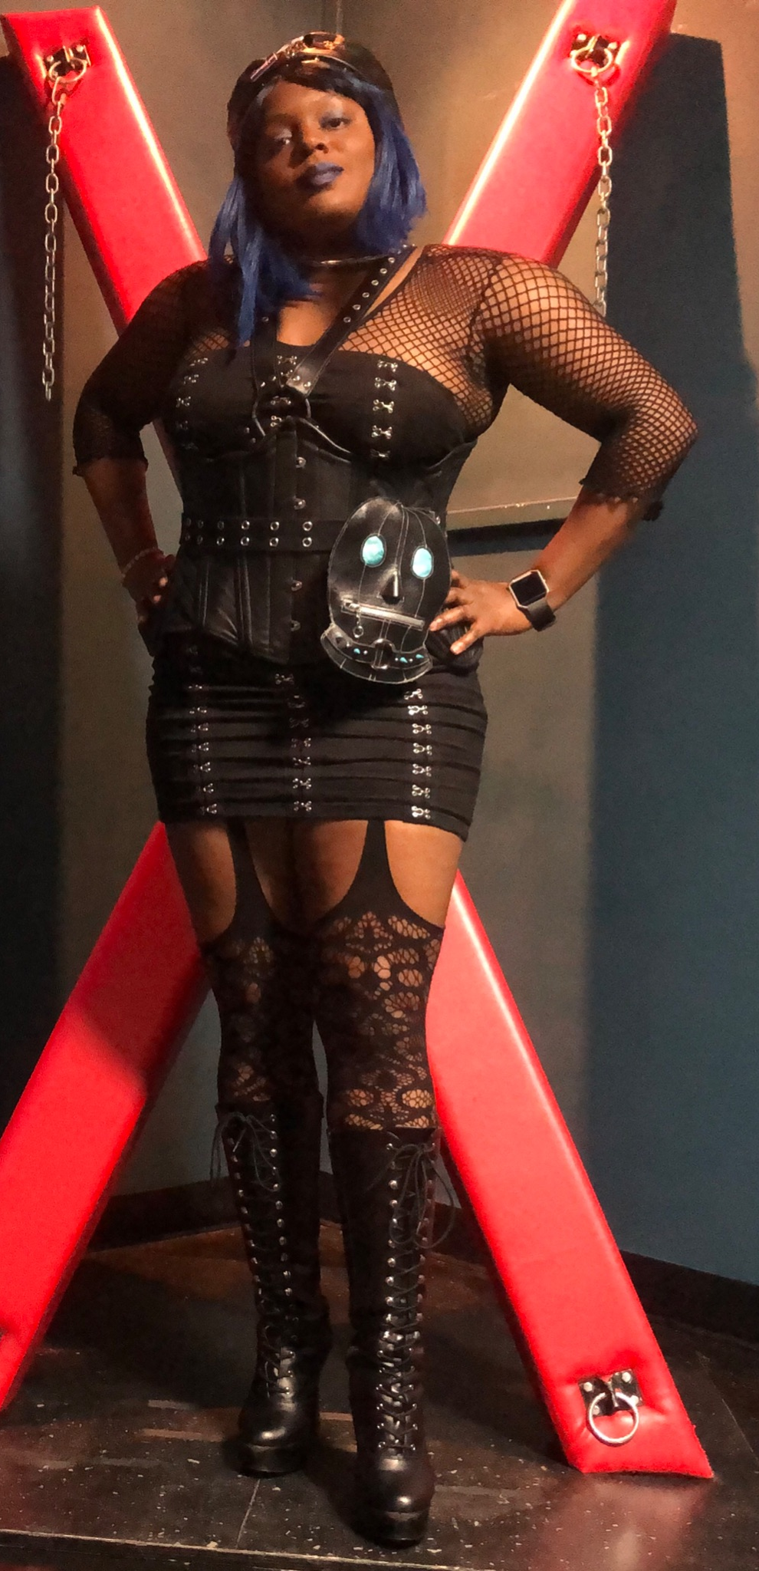
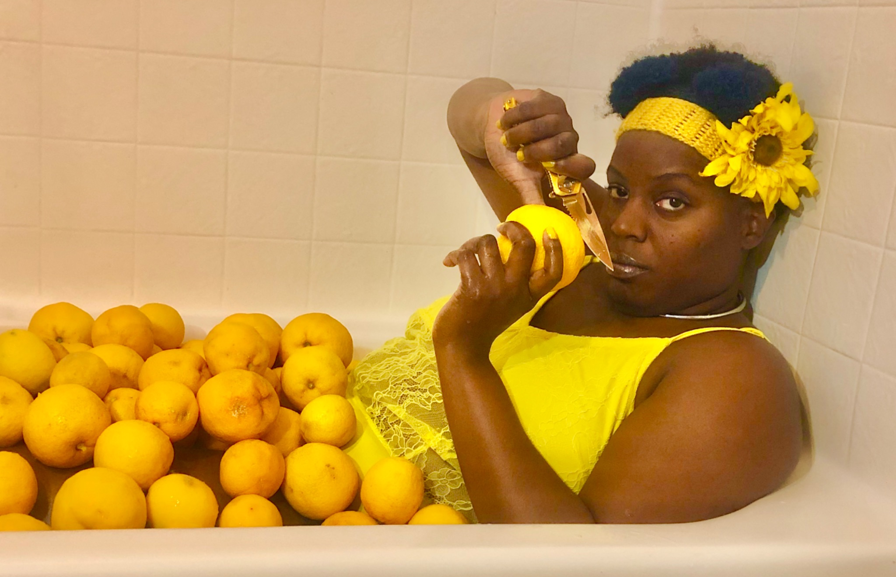
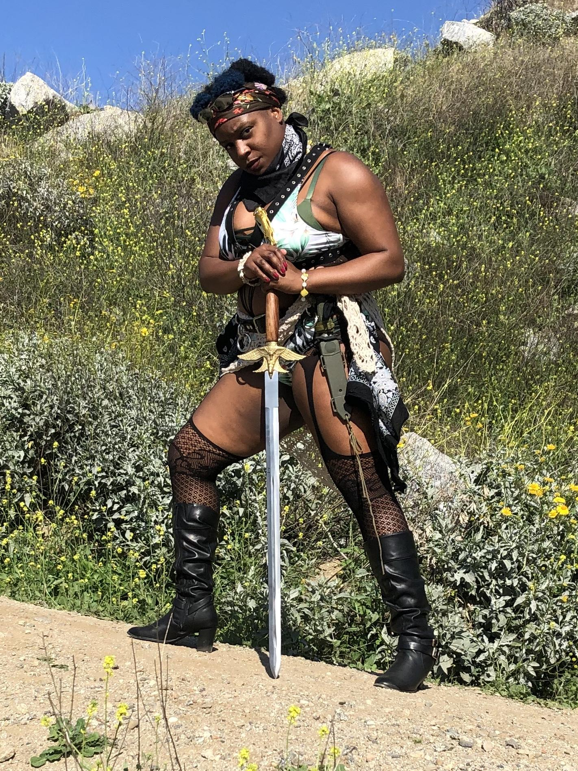
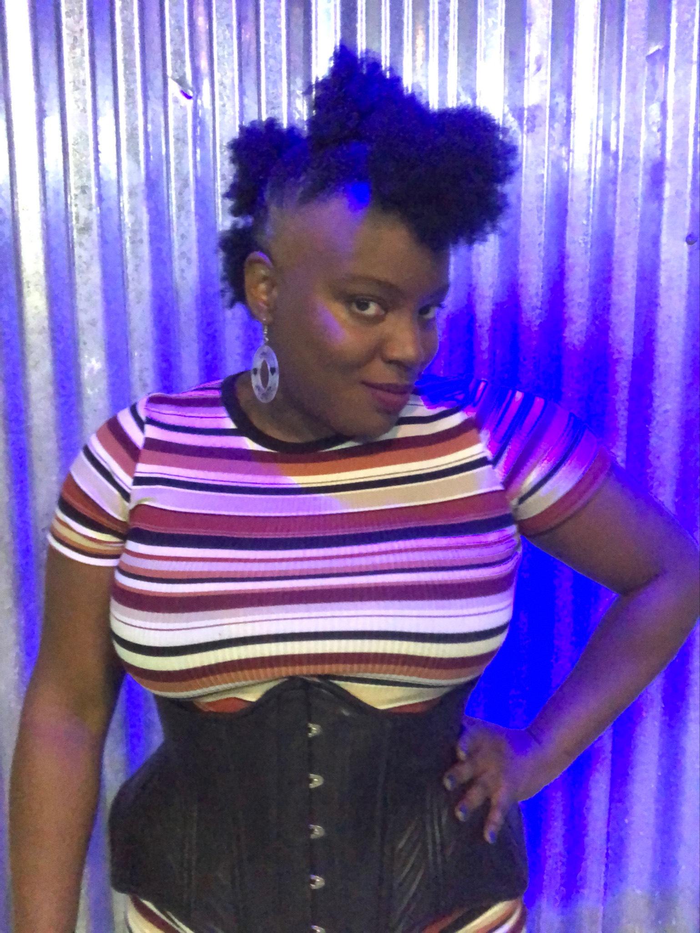
Who is the Ana Blue?
CVS Receipt of Identification
-Thicc
-Black
-Ethically Non-Monogamous
-Catholic apostate
-Polyplay
-Pansexual
-Sadomasochistic
-Leather
-Kinkster
-Pro Dominatrix
-Lifestyle Switch
-Leather Titleholder
-BDSM/kink Educator
-Content Creator
-Event Host
-Fetish Performer
-Female
-Queen
Why am I getting this certification?
-I have a gift for teaching
-I enjoy teaching
-I enjoy helping and changing lives
-I enjoy learning and growing
Stork drop off: California
Present bird’s nest: St. Louis, MO
Ana Blue
QueenAnaBlue.com
July 2024
Queen Ana Blue
QueenAnaBlue.com
Updated Jan 2023

Slide 3
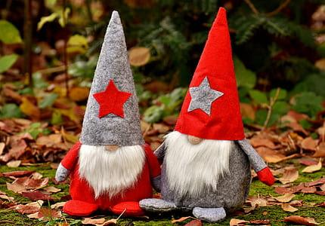
Question #1
How comfortable are you with being told you are wrong?
Hey, I think there was a mistake in your data.
Well, look at you being a nosey gnomey!
SpokesHub
Ana Blue QueenAnaBlue.com July 2024
Notes:
Even though we are professionals in some capacity, how do you feel when you aer told you are wrong or that you made a mistake?

Slide 4
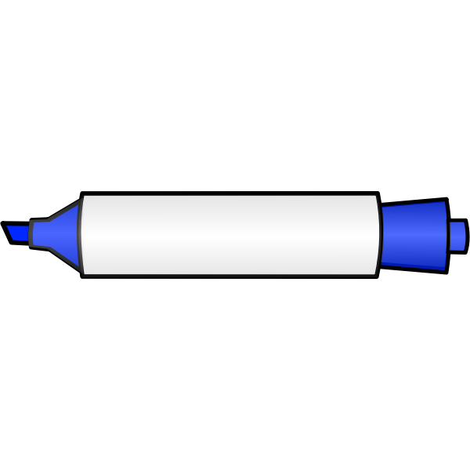
Objectives
The positive and negative effects of influencers on sex ed, sex work, and sexuality
What are some ways that Dan Savage has been a positive influence on the worlds of sex education, sex work, and sexuality?
What are some ways that Dan Savage has been a negative influence on the worlds of sex education, sex work, and sexuality?
How do we practice being open minded while being professional?
How do we practice critical thinking while being professional?
How do we practice accountability and contrition when we make mistakes as professionals?
Ana Blue
QueenAnaBlue.com
July 2024

Slide 5
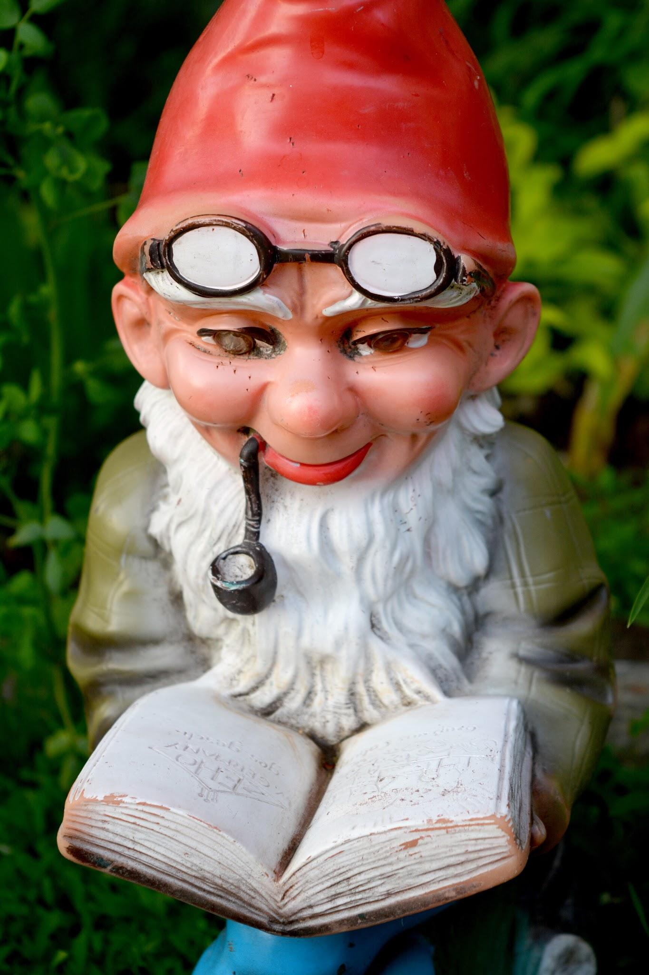
Question #2
What comes to mind when you hear or read the name Dan Savage?
Very interesting…
SpokesHub
SpokesHub
Ana Blue QueenAnaBlue.com July 2024

Slide 6
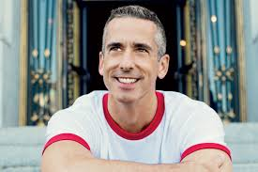
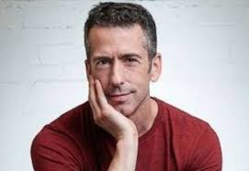
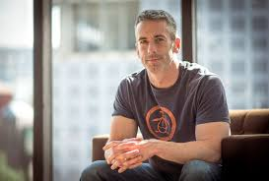
Who is Dan Savage? The Good
Popular for his sex-advice and sexy film festival
“Savage Love” sex-advice column, weekly in ‘The Stranger’, 1991
Author, journalist, LGBT community activist
Savage Lovecast, weekly call-in podcast, 2006
HUMP! Sex-Positive Film Festival
IGBP: It Gets Better Project, offers hope to LGBT kids
SpokesHub
Ana Blue QueenAnaBlue.com July 2024

Slide 7
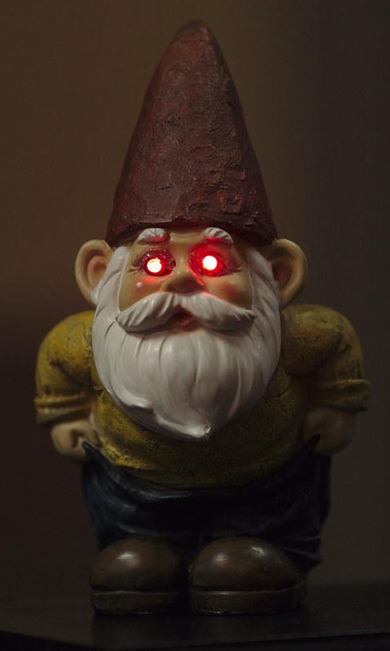
Who is Dan Savage? The Not-So-Good
Does being controversial and aggressive really help?
Should you use Shame as a therapeutic and educational tool?
Jesse Singal and conversion controversy interview with Dr. Erica Anderson, GLAAD
Should we be respectful of slurs and not use them?
SpokesHub
Ana Blue QueenAnaBlue.com July 2024

Slide 8
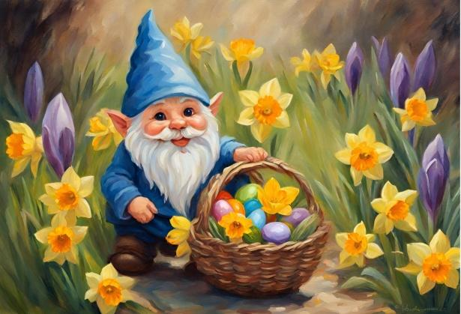
Question #3
Are all educators and people in the spotlight perfect people?
Would you garden with me? I’d garden with me!
SpokesHub
Ana Blue QueenAnaBlue.com July 2024

Slide 9
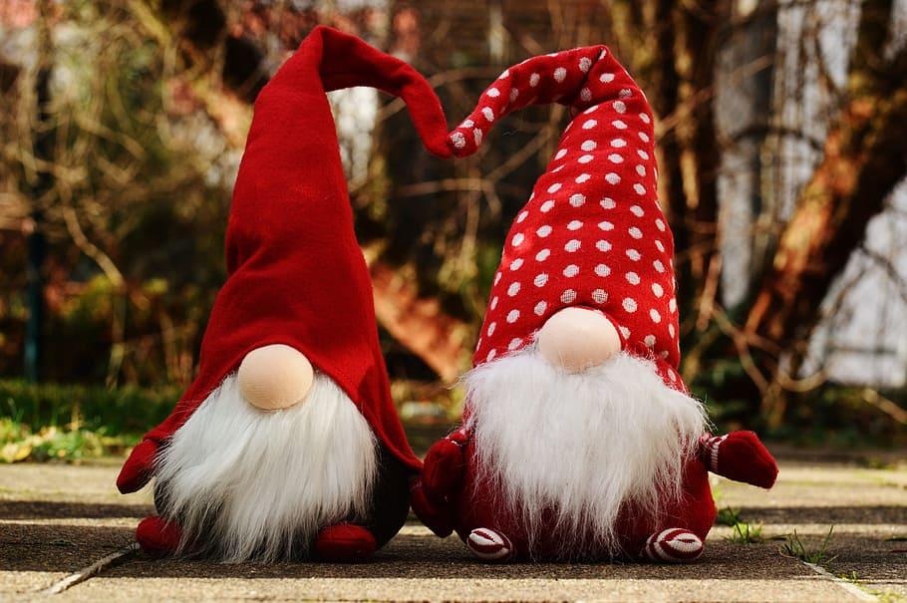
Positive Influence of Influencers
Spread information to isolated areas
Diversified knowledge
Humor
We love our fans!
Yes, thank you for your money!I mean LOVE!
Distraction
Source of income
SpokesHub
Ana Blue QueenAnaBlue.com July 2024

Slide 10
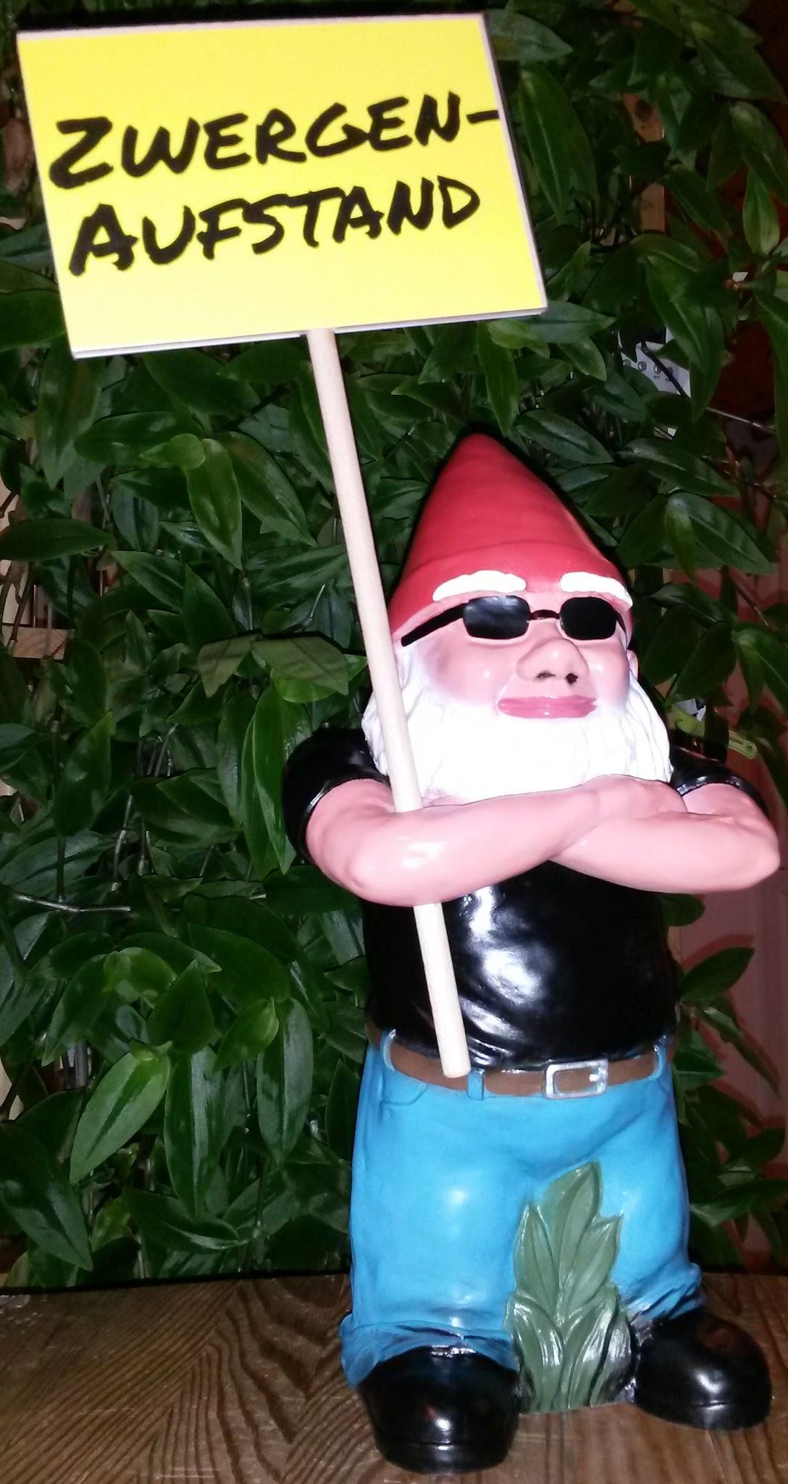
Negative Influence of Influencers
Incorrect information
Encourage damaging behavior
Everything on the internet is totally true!
Sell bad products
Make it look easy, fake persona, fantasy world
SpokesHub
Ana Blue QueenAnaBlue.com July 2024

Slide 11
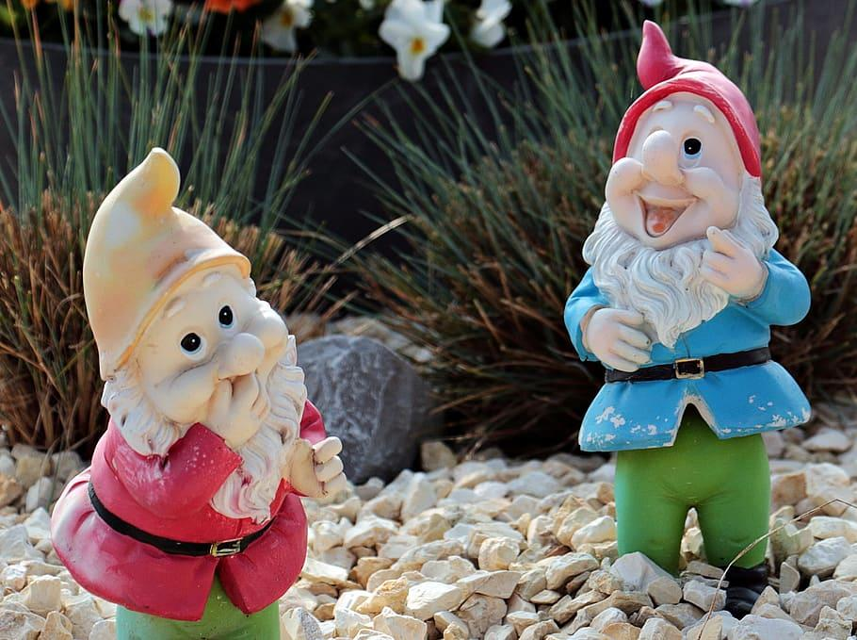
Question #4
Are Positive and Negative always subjective? Positive and negative for who?
Let’s agree to disagree but this was a great conversation!
SpokesHub
Ana Blue QueenAnaBlue.com July 2024
Notes:
What might be good for you, might only be good for the few

Slide 12
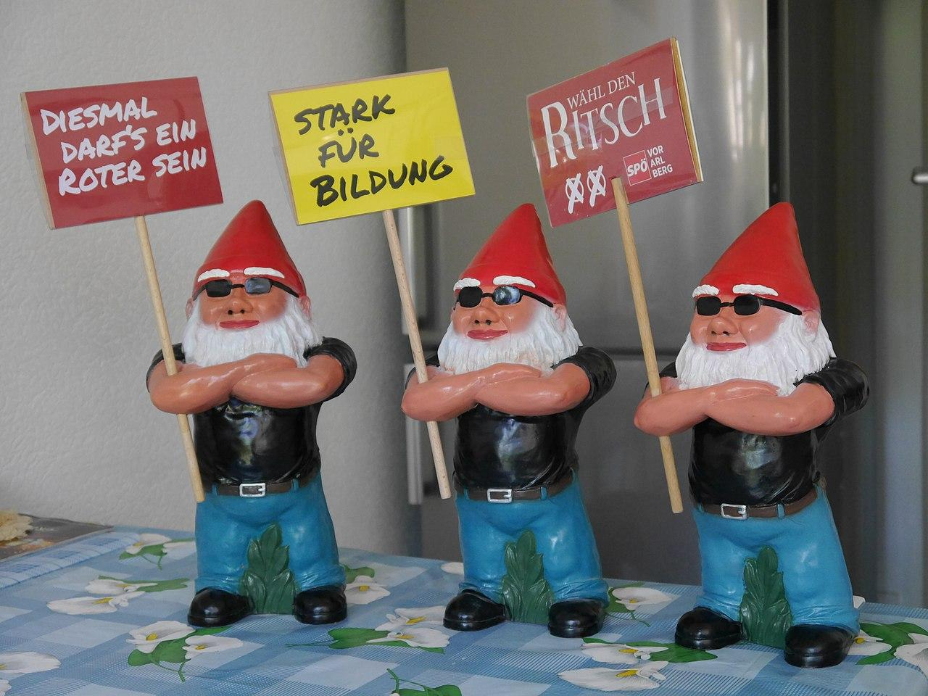
Terms, labels, and bios! OH MY!
Identification and understanding
Self-confidence
Certain labels with certain groups (bi vs pan)
Non-
gender
Pansexual, Bear
Demisexual, Masc Daddy Domme
New terms and labels being made all the time
Too many labels?
SpokesHub
Ana Blue QueenAnaBlue.com July 2024

Slide 13
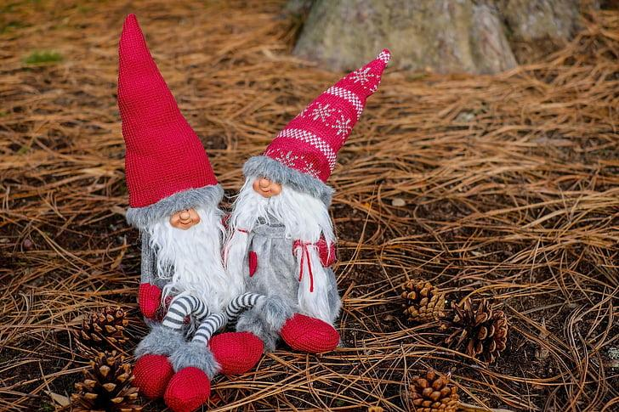
Question #5
Can new stuff hurt more than help?
Try this!
It is totally, absolutely 200% safe with hardly any side effects!
SpokesHub
Ana Blue QueenAnaBlue.com July 2024

Slide 14
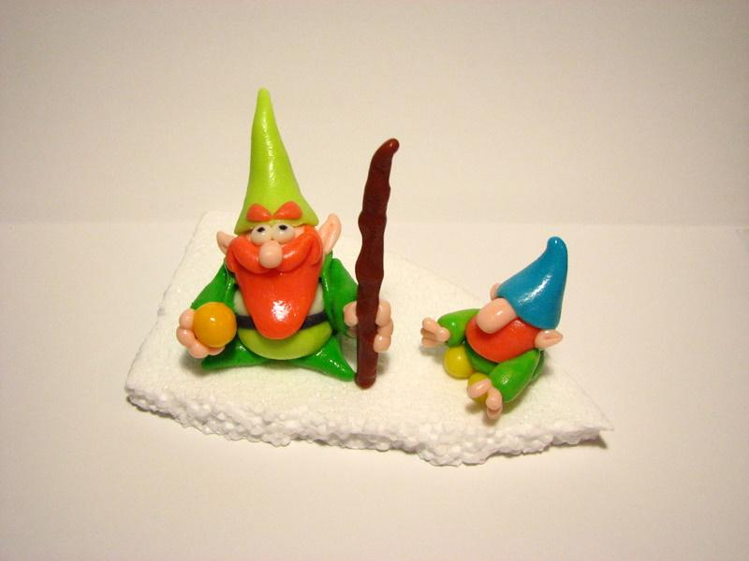
Tolyamory: T rhymes with P except after D…for Dan Savage
Tol: Latin root word for “tolerance”
Partner A is tolerant of Partner B having outside sexual relations, even if the partner is cheating
I will just tolerate your intolerance of my new term!
Poly: Greek, many
Dan, do we really need this term?
-amor: Latin, love
TRUE Polyamory is consensual
Tolyamory does not help with sex positivity
A term for cheating
Confuses people with polyamory who already have negative views on polyamory
SpokesHub
Ana Blue QueenAnaBlue.com July 2024

Slide 15
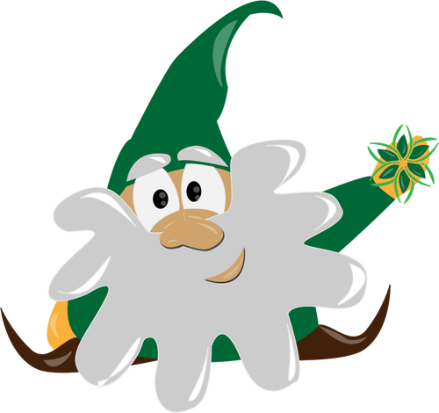
What is a better term/word/phrase than Tolyamory?
Do we need a term that describes “hey my partner is having relationships and being sexual with people without telling me and I do not like this but I will not discuss my discomfort with my partner”...hence the TOLERANCE part
Why does the word have to sound like “polyamory?”
Labels and terms are suppose to HELP not confuse
It’s fine! I’m fine!
Totally fine!
*cue David Attenborough* It indeed was not fine.
SpokesHub
Ana Blue QueenAnaBlue.com July 2024

Slide 16
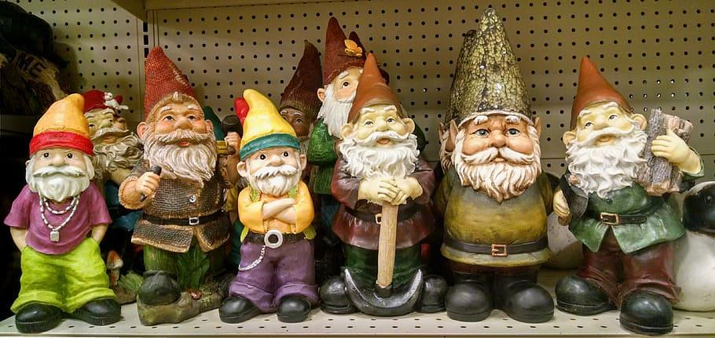
Summary
Use your influence wisely
You will be wrong
We got this!
Try to be as accurate as possible
Accountability
Life-long students
People relate to humanness
Being aggressive and controversial is not always productive and educational
Critical Thinking and being Open-Minded are important
SpokesHub
Ana Blue QueenAnaBlue.com July 2024

Slide 17
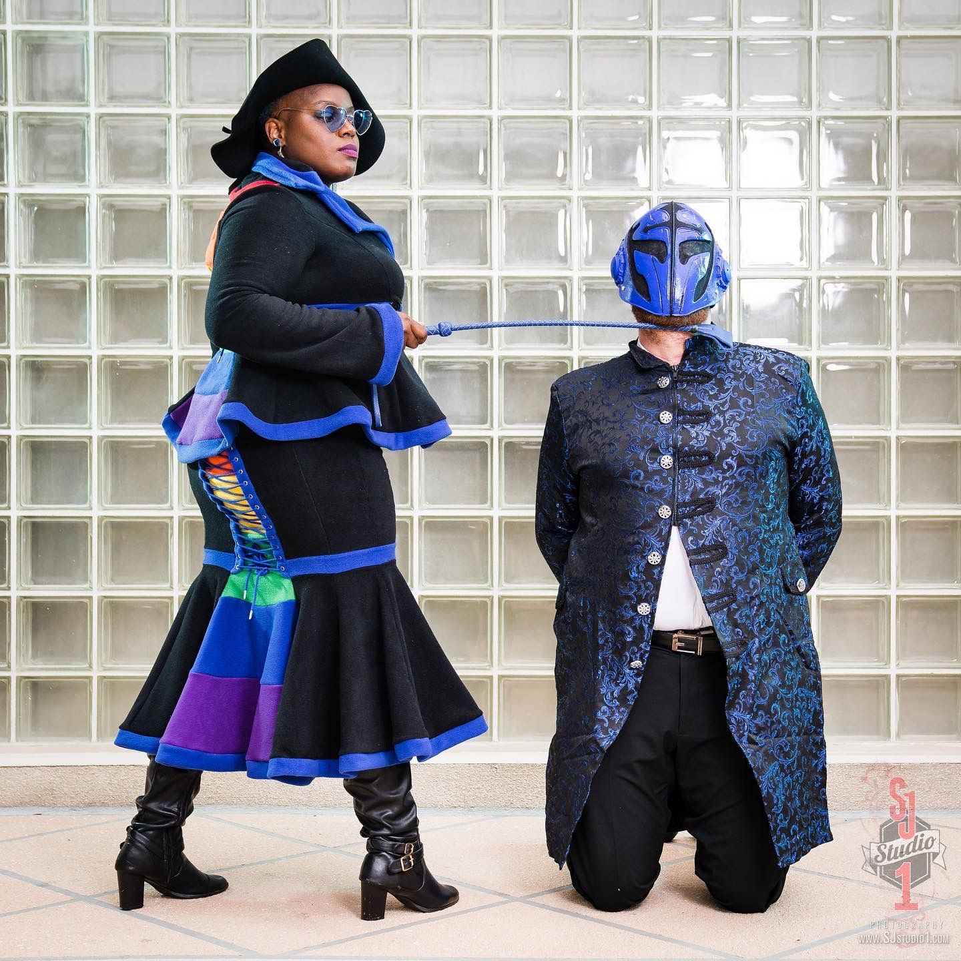
Thank you for attending!
Email:
TheQueen@QueenAnaBlue.com
IG:
Queen_Ana_Blue
SpokesHub
Ana Blue
QueenAnaBlue.com
July 2024

