Slide 1
Processing Grief through Sex Work
as discussed by KWD

Slide 2
Content Warning
There will be discussions of death, addiction, suicide, and overdose

Slide 3
Quick Note on Language
We: Sex Workers Rights Advocates: Human Rights Advocates: LGBTQ+ Rights Advocates
Stripper: Dancer: Sex Worker
Sex Work: Work: Job
I use some words interchangeably.
Not to the detriment of either word, or in a way that is meant to baffle… and I will try to avoid long-winded stories.
I think it is important to confirm:
Client: ⁽¹⁾someone who uses adult services in person, virtually, occasionally, or often; ⁽²⁾someone who uses government services such as healthcare aid, filing taxes, or a public library.

Slide 4
Who the hell am I?
I was a bouncer, DJ, doorman, bartender, and dancer at the first club I worked at. I was young and a little drunk, but I would not trade that experience for anything.
I transitioned to try other forms of work during/after the pandemic, and have quicky fallen in love with my hobbies and clients.
I have been a Sex Worker’s Rights Advocate, now for Full Decrim, since my second year of SUNY, when I transitioned out of ‘Primary Education’ and into ‘Sociology’ and ‘Womxn’s, Gender, and Sexuality Studies’.
I am a first generation sex worker to the best of my knowledge, based on all of the interactions I have had with my family during the slow coming out process as a stripper.
I have been a Sex Worker since 2018; taking time off only during parts of the [Covid-19] pandemic, and after my dad passed in 2021.

Slide 5
Crying on the Job
…anyone can do it!

Slide 6
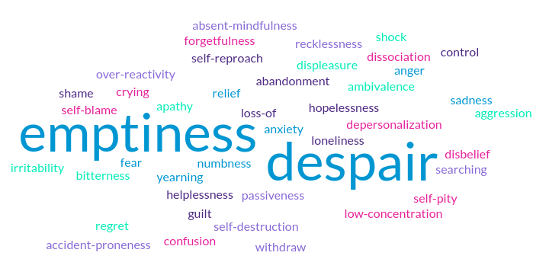
What are ‘Side Effects of Grief’?
confusion
hollowness in stomach
‘grief flu’
loss of control
change in appetite

Slide 7
Where do we hide Grief?
In anger at ourselves, at those who have passed, at strangers
Are we short circuiting on the phone with customer service because we are mad at the wait time? Or because we are left with a mess to clean up when *someone* had to go and pass away?
Tardiness
Which manifested for me as a one-two punch of ‘time-blindness’ and ‘lethargy’
Brain fog
I promise your rational thinking will return one day
Memory loss
The brain is so busy processing what the hell just happened, it will have trouble recalling even the most important information in that moment

Slide 8
How does grief appear in our work?
1
[Clients] who are grieving loss of partners, family
2
[Clients] who may be struggling with mental health or depression
3
The grief [We] try to check at the door, but might see triggered
How can ‘safe intimacy’ possibly be considered a human right?
Key Points when we Advocate on Behalf of Sex Work
The Illinois Dept of Health [who seems reliable enough] shares that Suicide is the #8 cause of death in men
Although “Unintentional Injuries” is #3…
Unfortunately, as Adults, We must navigate our own emotional reactions, sometimes as a response to others.
How can we redirect and refocus to ensure no one, not even ourselves, gets hurt?

Slide 9
1. The ‘Work’ of Emotional Labour
It is this big loud secret that Americans [men] are afraid of therapy. It is also a big loud secret that most often the people who are engaging in the consensual adult industry are people [men] with wealth providing excess income to people without. Is it a far stretch to ask, Are Sex Workers Therapeutic?
I’d like to pose a real-world example for discussion:
A friend of mine has a client, who reached out to her in February 2024. His wife, Molly* passed from a long battle with cancer in November 2023. My friend is blonde, his late wife was blonde.
He spends most of their sessions speaking only of Molly, and, with consent, requests my friend ‘be Molly’ when she feels comfortable.
*name has been changed

Slide 10
Where are all the resources?
Finding published work on ‘sex while grieving’ proved to be more than a little difficult. Sex After Grief, published in 2019 and written by Joan Price, was a hidden gem I uncovered¹ while scouring the mental health sections of bookstores.
Plenty of books discussing grief only lightly poke at the idea of ‘sexual relations’ after losing a loved one, and a majority are directed towards widows, with the chapters suggesting to, of course, go at your own speed.
Price included a chapter called Massage or More? discussing the importance sex workers and similar providers can have to those who are only looking to feel connected to another human again, not necessarily start dating again.

Slide 11
I have processed grief with a sex worker before.
I have processed grief as a sex worker before

Slide 12
Advocacy Points along the Lines of Mental Health
When we are well versed in language surrounding healing our own emotional wounds, we can speak on our experiences as a way to educate others
We can provide a space for those around us to feel safe exploring previously painful thoughts
To date responsibly as an adult involves taking care of our emotional baggage so it does not spill onto those we love
Someone with little-to-no experience dating could really benefit from hiring a professional for guidance

Slide 13
Corrine
“Seeing a sex worker is more than just sex. Sometimes it’s about getting some of the feel-good brain chemicals back. Touch involves the hormone oxytocin and sex is a complex mix of oxytocin, dopamine, and vasopressin. In my experience, seeing a sex worker during grief brings out a level of vulnerability. By making a booking, you are cementing the decision to recognize your need to be open, to feel. If you are unsure about seeing a sex worker when you are grieving, wait. We can’t fix things for you, or make things right. But when you are ready, we can help you to feel connected to a human again, with no judgement or expectations.”
of Tasmania, Australia
excerpt from Sex After Grief

Slide 14
2. Witnessing Mental Health Disasters at Work
> How do you know when you need your Hard Hat?
…or your Thinking Cap?
“Is this client being obscene, or is this client struggling with loneliness//depression?”
> Clients struggling with addiction
> Grieving the loss of clients – to Death or to Disrespect
Loss of steady income
Loss of a ‘friend’ // ‘coworker’

Slide 15
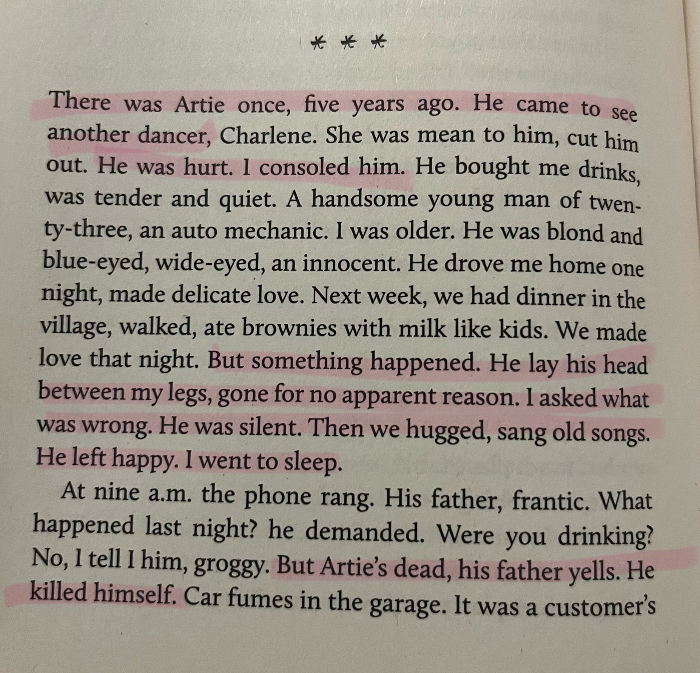
Susan Walsh - Whorephobia - pg. 170-172

Slide 16
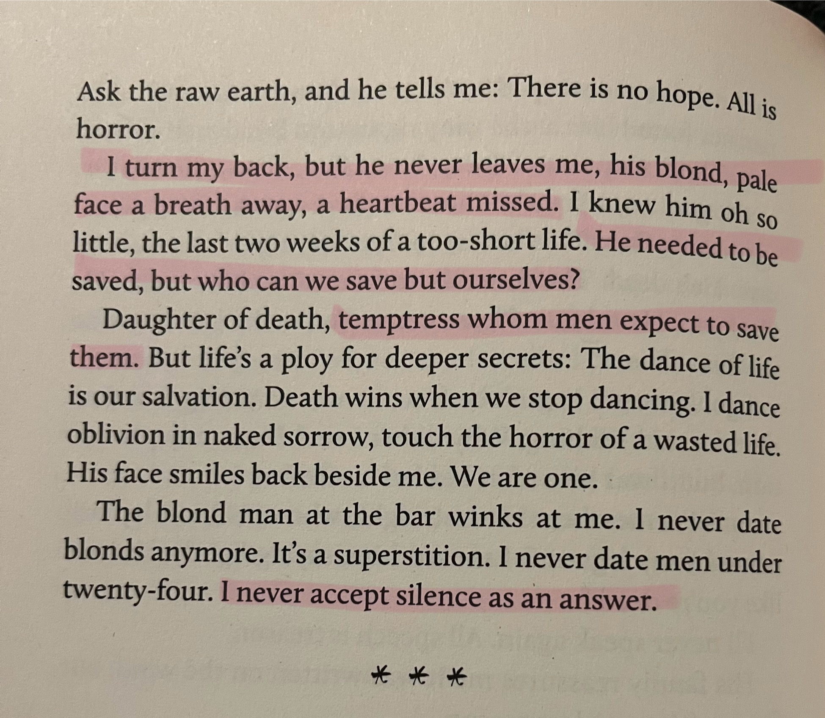
Susan Walsh - Whorephobia - pg. 170-172

Slide 17
3. When I was a Young Stripper…
What I look out for now, as best I can, are actions typical for and thoughts said aloud that a person considering serious self harm might display.
-Why is this person reaching out now?
-What kind of support system does this person have at home?
…I had moments of inappropriate-for-work behavior, as aligned with my current self-healing oriented goals.
Having danced, and entertained, and de-escalated, sober and intoxicated, I prefer to be the party when I am in a sound state of mind and body. I grieve not knowing what I did and what I heard and who I saw while I was intoxicated on the job.

Slide 18
You are In Charge of You
When we have ‘trauma dump stories’ imposed on us while in a Statehouse, or we’re asked rude and personal questions* while tabling and on-the-job, or come face-to-face with the [knowledge] that healing isn’t linear, How do We Stay Focused?
Stay Confident– no one knows how you are feeling until you tell them, so if you remain calm and assured in your tone, you will be believed
Deep Breath– continue ‘thinking’ before ‘speaking’, there’s no reason to ever add fuel to a hateful fire
Go at Your Own Pace– there is no timeline to your grief
*‘worst experiences’, ‘weirdest client’, ‘arrest history’, etc

Slide 19
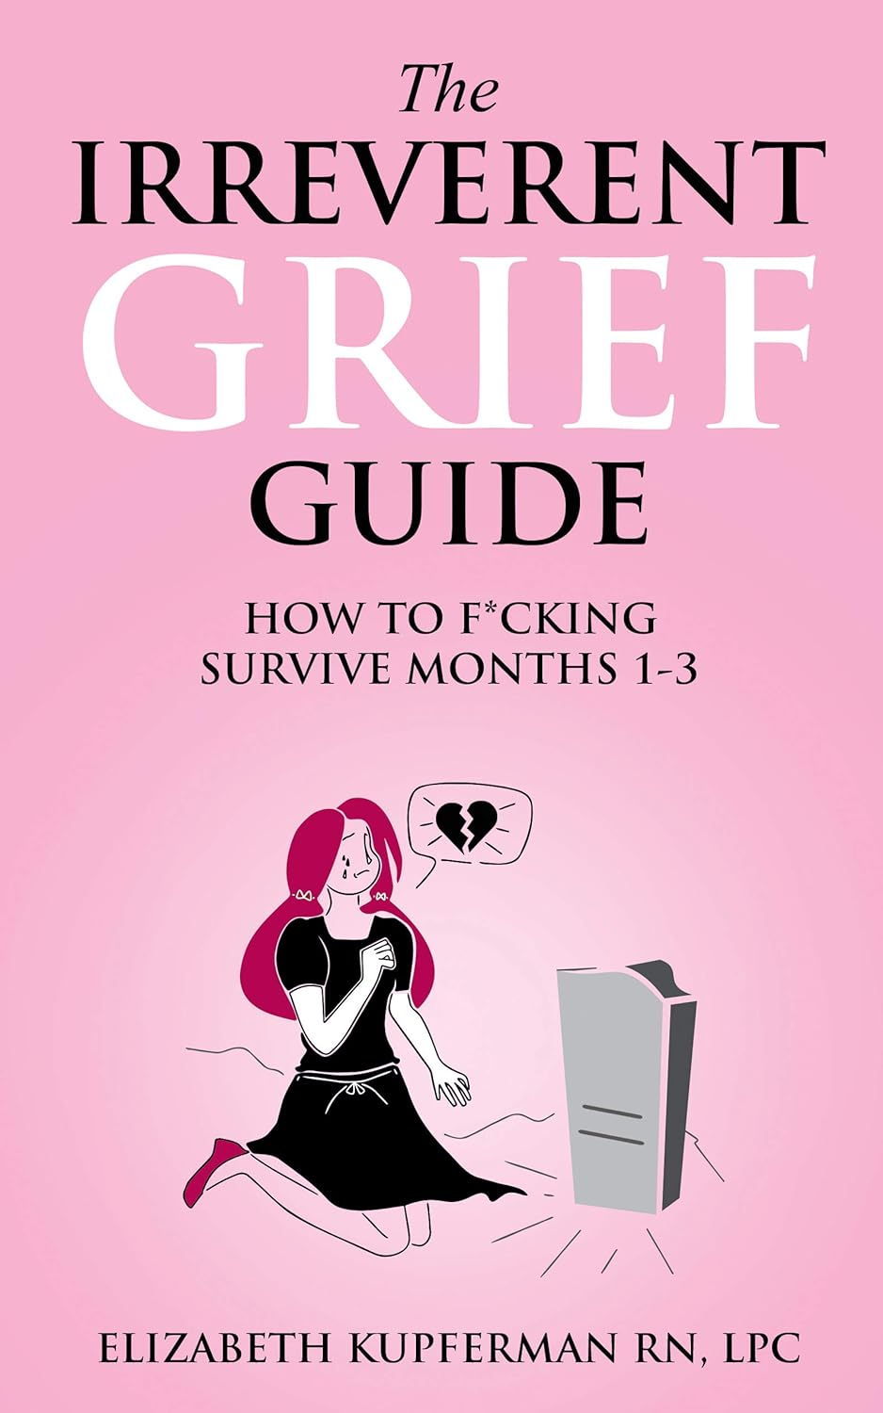
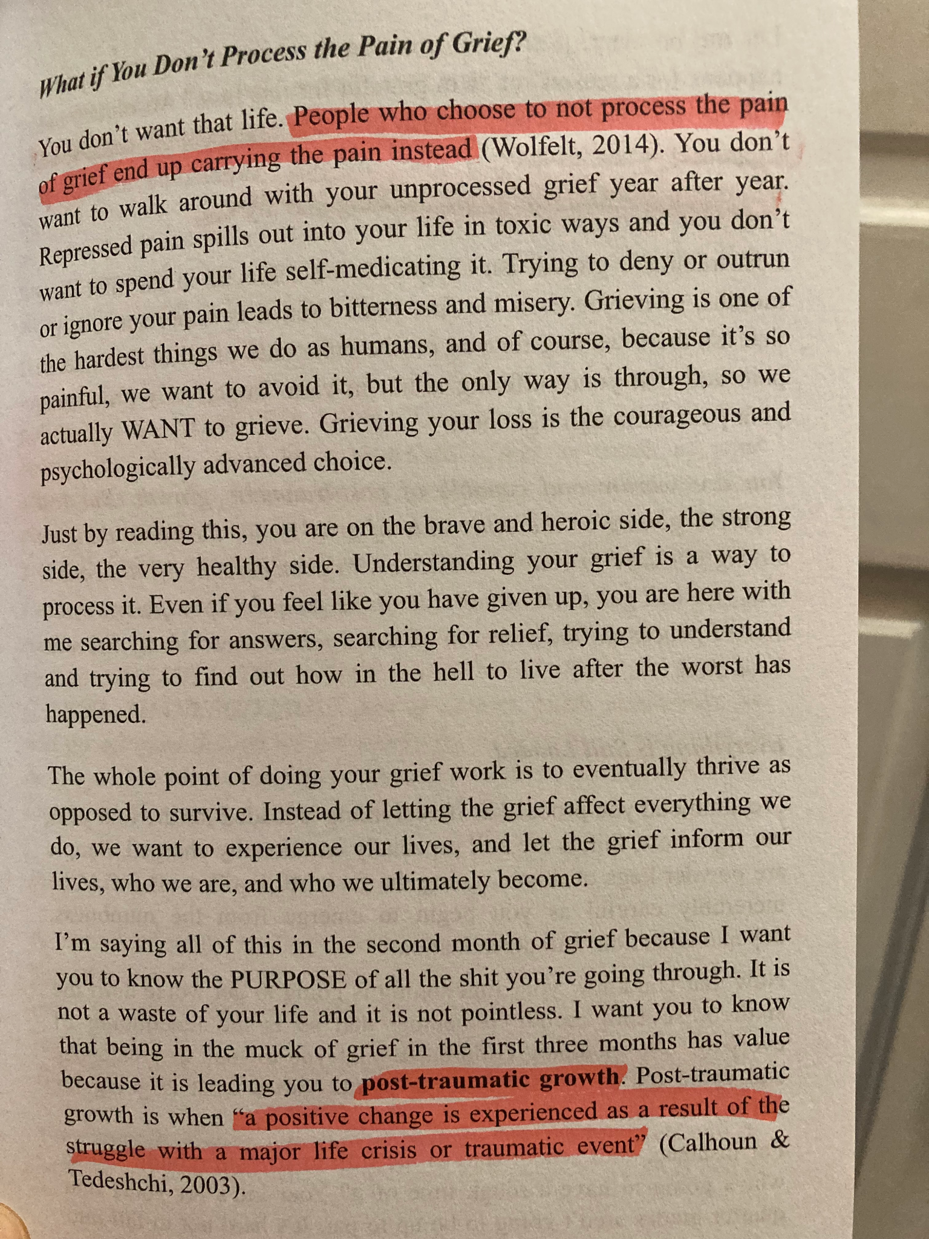
Struggling?
…this could help:

Slide 20
An active sex worker since 2018, KWD advocates regularly in Northeast Statehouses on behalf of Full Decrim and any related healthcare, gender, and LGBTQ+ legislation. They attend meetings and events as a member of the Oregon Sex Worker’s Committee, where she got her start in advocacy, and was introduced to The Ishtar Collective alongside other like-minded human rights organizations.
They hope to keep writing and speaking in impactful ways for the ‘Rights Not Rescue’ movement; with long term goals of inclusive sex education and the right to safe intimacy.

Slide 21
Resources
Borden, Lizzie. Whorephobia: Strippers on Art, Work, and Life. Seven Stories Press, 2022.
Harper, Faith G., and Erin Bennett. Unfuck Your Grief: Using Science to Heal Yourself and Support Others. Blackstone Publishing, 2022.
Kupferman, Elizabeth. The Irreverent Grief Guide: How to F*cking Survive Months 1-3. Independently Published, 2020.
Price, Joan. Sex After Grief: Navigating Your Sexuality after Losing Your Beloved. Mango, 2019.
¹ ‘uncovered’ is being used loosely, as I needed to ask an employee of Powell’s for assistance, and they had not sold this book in stores for 4 years. Upon looking into my local library, it was only available as an e-book. It does seem to be available in paperback online.

